Slide 1

Author: Autar Kaw et. al.
TEXTBOOK: NUMERICAL METHODS WITH APPLICATIONS

Slide 2
Nonlinear Regression

Slide 3





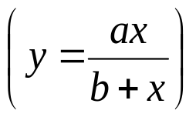



Nonlinear Regression
Some popular nonlinear regression models:

Slide 4










Nonlinear Regression
Given n data points
best fit
to the data, where
is a nonlinear function of
.
Figure. Nonlinear regression model for discrete y vs. x data

Slide 5

http://numericalmethods.eng.usf.edu

Slide 6




Exponential Model
Given
best fit
to the data.
Figure. Exponential model of nonlinear regression for y vs. x data

Slide 7
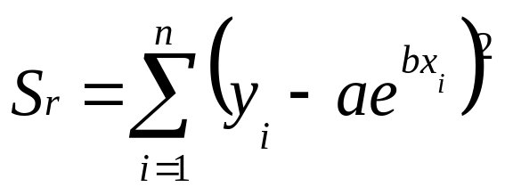
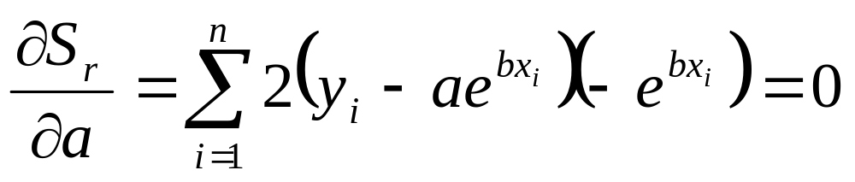

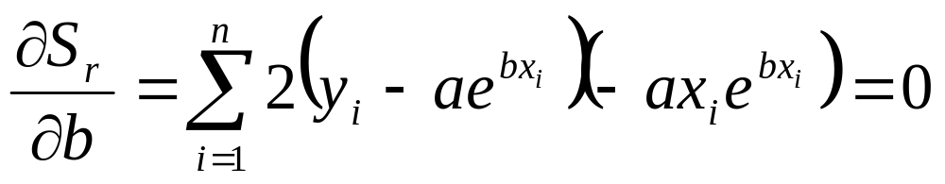

Finding Constants of Exponential Model
The sum of the square of the residuals is defined as
Differentiate with respect to a and b

Slide 8
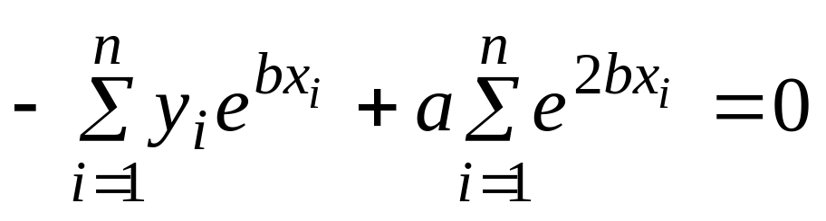
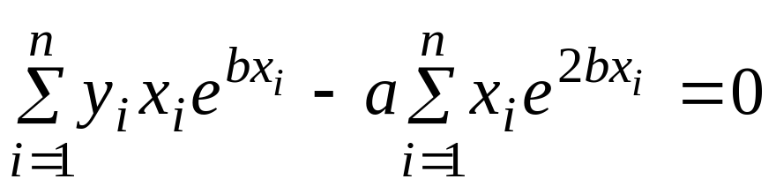
Finding Constants of Exponential Model
Rewriting the equations, we obtain

Slide 9
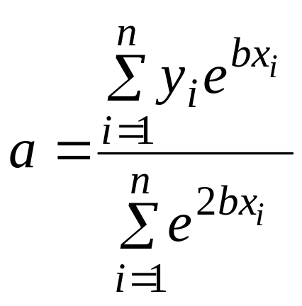
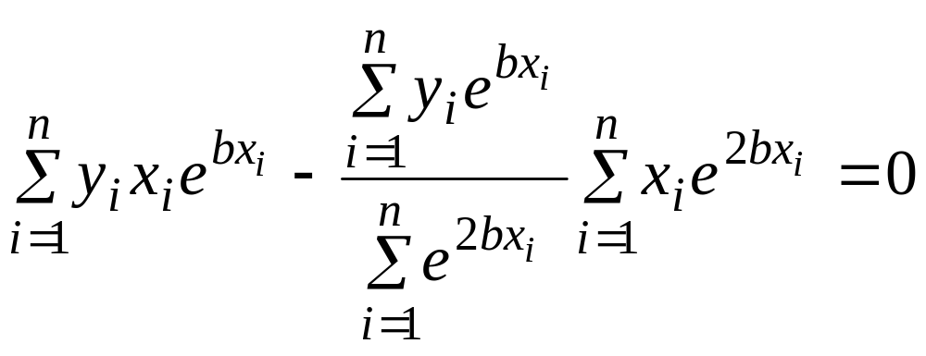
Finding constants of Exponential Model
Solving the first equation for a yields
Substituting a back into the previous equation
The constant b can be found through numerical methods such as bisection method.

Slide 10

Example 1-Exponential Model
Many patients get concerned when a test involves injection of a radioactive material. For example for scanning a gallbladder, a few drops of Technetium-99m isotope is used. Half of the Technetium-99m would be gone in about 6 hours. It, however, takes about 24 hours for the radiation levels to reach what we are exposed to in day-to-day activities. Below is given the relative intensity of radiation as a function of time.
Table. Relative intensity of radiation as a function of time.
t(hrs) | 0 | 1 | 3 | 5 | 7 | 9
 | 1.000 | 0.891 | 0.708 | 0.562 | 0.447 | 0.355

Slide 11
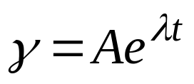


Example 1-Exponential Model cont.
The relative intensity is related to time by the equation
Find:
a) The value of the regression constants
and
b) The half-life of Technetium-99m
c) Radiation intensity after 24 hours

Slide 12
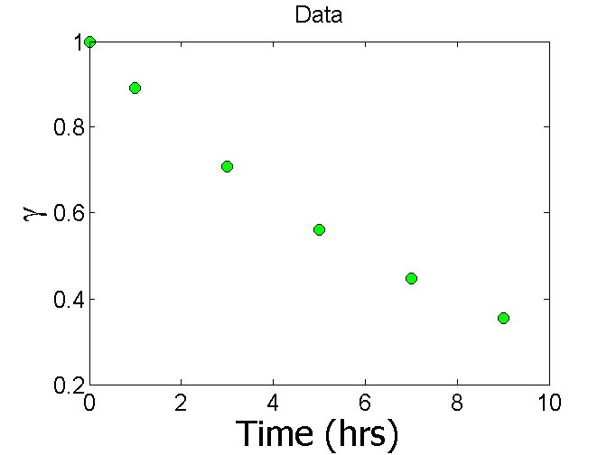
Plot of data

Slide 13
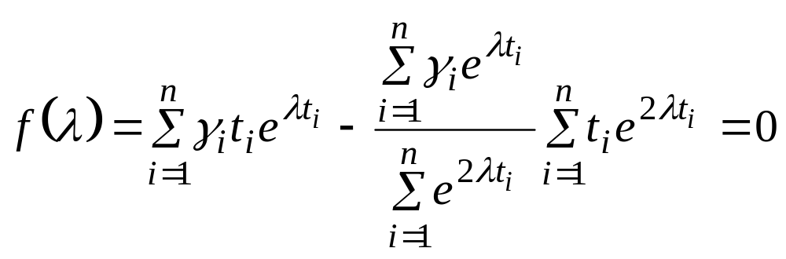
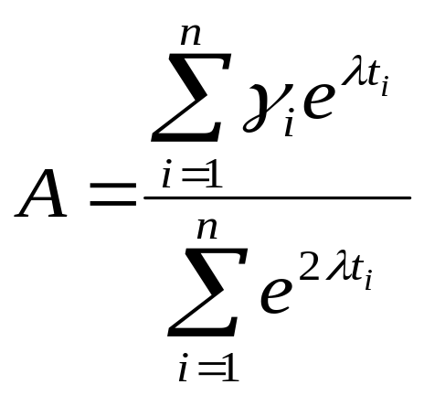
Constants of the Model
The value of λ is found by solving the nonlinear equation

Slide 14
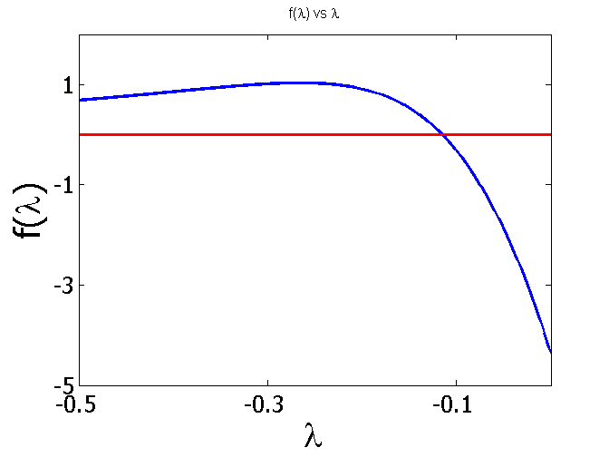
Setting up the Equation in Python
t (hrs) | 0 | 1 | 3 | 5 | 7 | 9
γ | 1.000 | 0.891 | 0.708 | 0.562 | 0.447 | 0.355

Slide 15
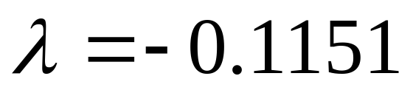
Setting up the Equation in Python
t=[0 1 3 5 7 9]
gamma=[1 0.891 0.708 0.562 0.447 0.355]
syms lamda
sum1=sum(gamma.*t.*exp(lamda*t));
sum2=sum(gamma.*exp(lamda*t));
sum3=sum(exp(2*lamda*t));
sum4=sum(t.*exp(2*lamda*t));
f=sum1-sum2/sum3*sum4;

Slide 16
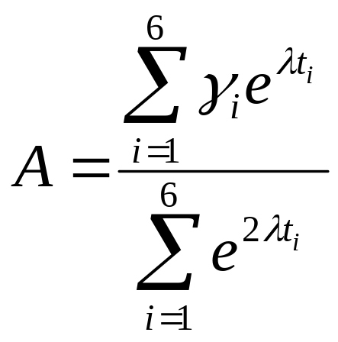

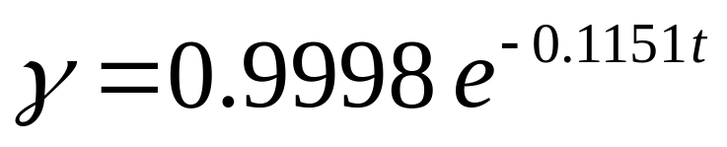
Calculating the Other Constant
The value of A can now be calculated
The exponential regression model then is

Slide 17
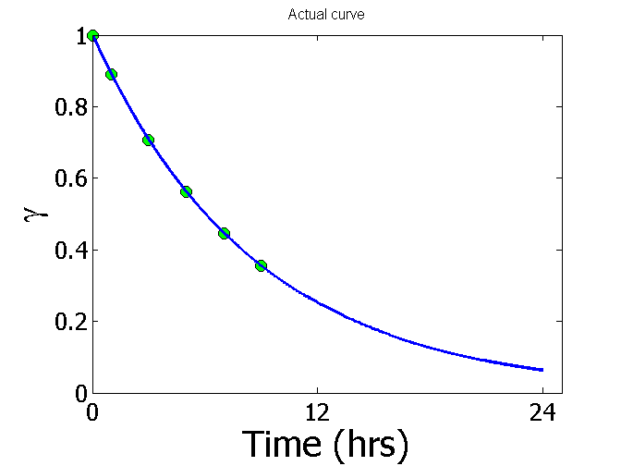
Plot of data and regression curve

Slide 18
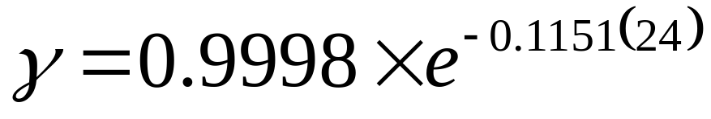
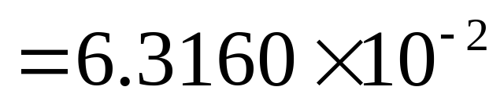
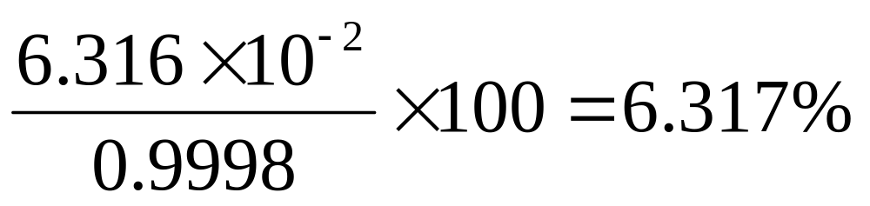
Relative Intensity After 24 hrs
The relative intensity of radiation after 24 hours
This result implies that only
radioactive intensity is left after 24 hours.

Slide 19
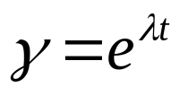
Homework
What is the half-life of Technetium-99m isotope?
Write a program in the language of your choice to find the constants of the model.
Compare the constants of this regression model with the one where the data is transformed.
What if the model was ?

Slide 20

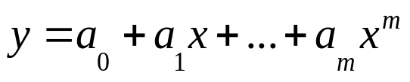



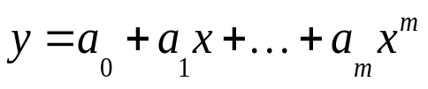
Given
best fit
to a given data set.
Figure. Polynomial model for nonlinear regression of y vs. x data

Slide 21

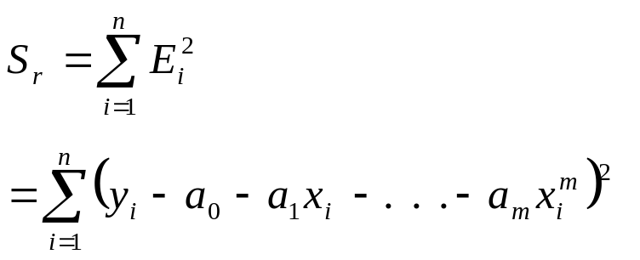
Polynomial Model cont.
The residual at each data point is given by
The sum of the square of the residuals then is

Slide 22


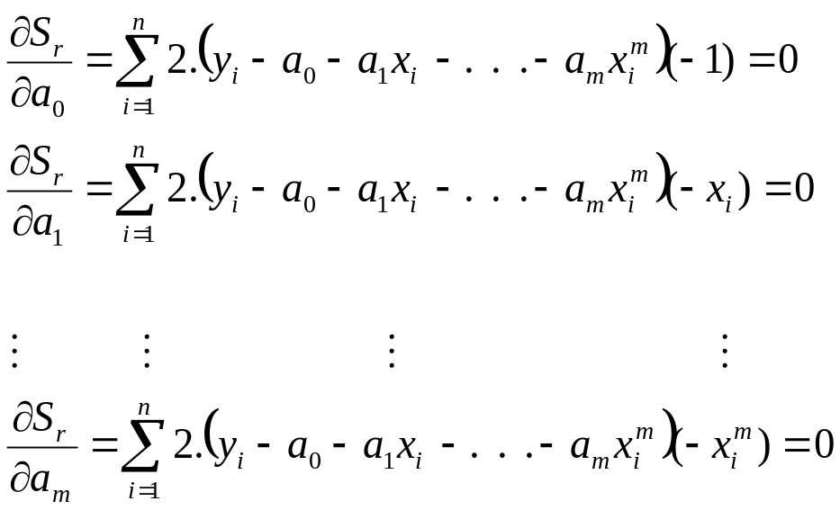






Polynomial Model cont.
To find the constants of the polynomial model, we set the derivatives with respect to
where
equal to zero.

Slide 23
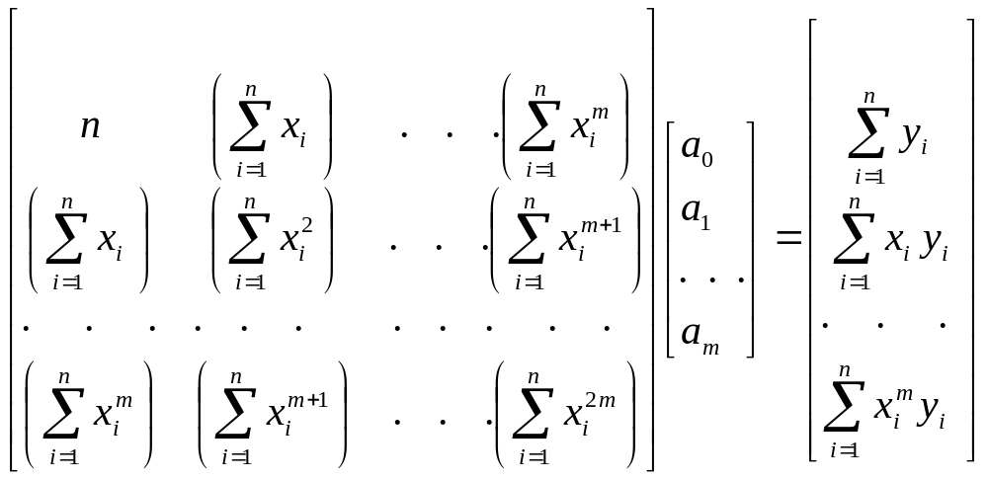

Polynomial Model cont.
These equations in matrix form are given by
The above equations are then solved for

Slide 24
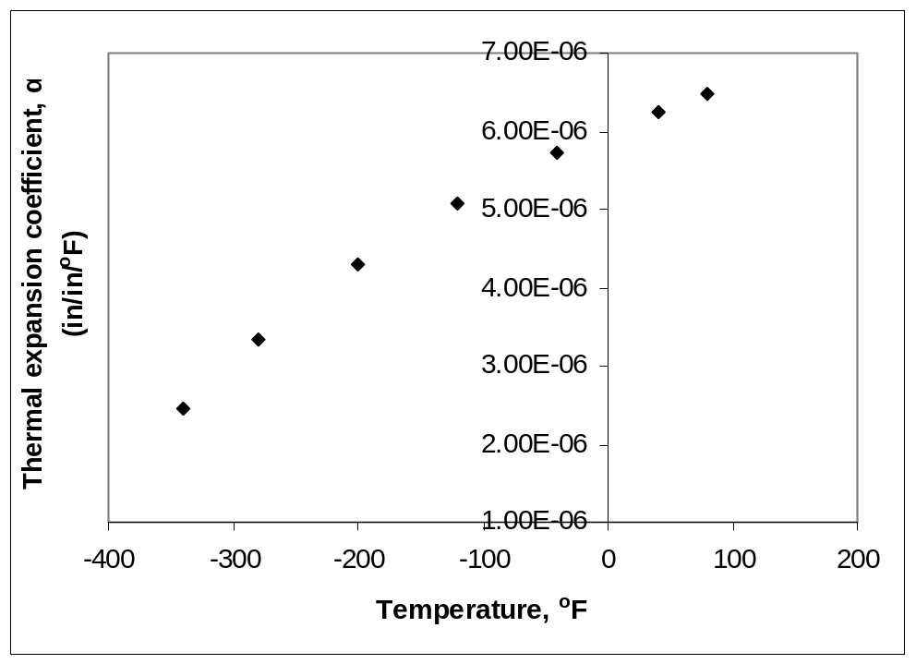

Example 2-Polynomial Model
Regress the thermal expansion coefficient vs. temperature data to a second order polynomial.
Table. Data points for temperature vs
Temperature, T (ºF) | Coefficient of thermal expansion, α (in/in/ºF)
80 | 6.47×10⁻⁶
40 | 6.24×10⁻⁶
−40 | 5.72×10⁻⁶
−120 | 5.09×10⁻⁶
−200 | 4.30×10⁻⁶
−280 | 3.33×10⁻⁶
−340 | 2.45×10⁻⁶
Figure. Data points for thermal expansion coefficient vs temperature.

Slide 25


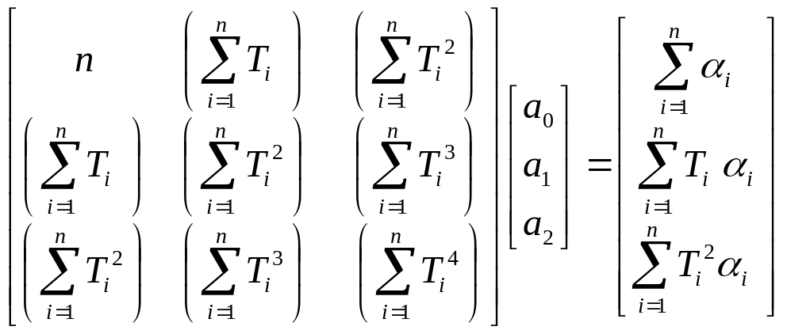
Example 2-Polynomial Model cont.
We are to fit the data to the polynomial regression model
The coefficients
are found by differentiating the sum of the
square of the residuals with respect to each variable and setting the
values equal to zero to obtain

Slide 26
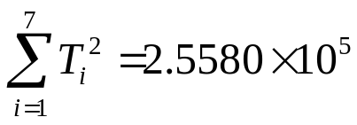
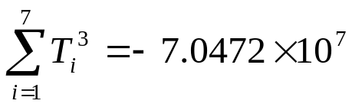
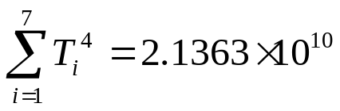
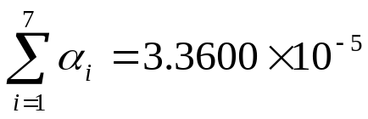
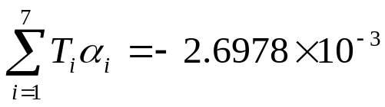
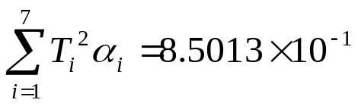
Example 2-Polynomial Model cont.
The necessary summations are as follows
Table. Data points for temperature vs.
Temperature, T (ºF) | Coefficient of thermal expansion, α (in/in/ºF)
80 | 6.47×10⁻⁶
40 | 6.24×10⁻⁶
−40 | 5.72×10⁻⁶
−120 | 5.09×10⁻⁶
−200 | 4.30×10⁻⁶
−280 | 3.33×10⁻⁶
−340 | 2.45×10⁻⁶

Slide 27
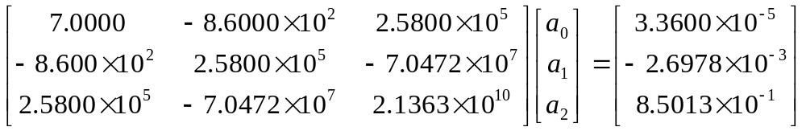
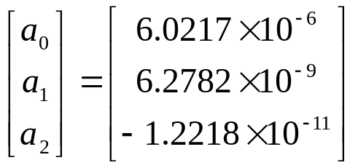


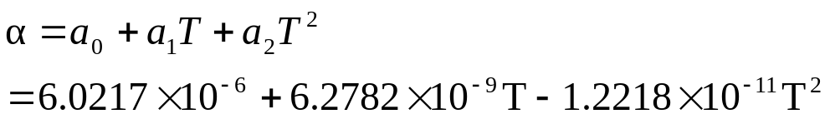

Example 2-Polynomial Model cont.
Using these summations, we can now calculate
Solving the above system of simultaneous linear equations we have
Calculator use kore ber kora jay
mode->stat->_+cx^2->reg
The polynomial regression model is then

Slide 28








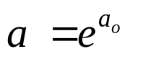




To find the constants of many nonlinear models, it results in solving simultaneous nonlinear equations. For mathematical convenience, some of the data for such models can be transformed. For example, the data for an exponential model can be transformed.
As shown in the previous example, many chemical and physical processes are governed by the equation,
Taking the natural log of both sides yields,
Let
and
We now have a linear regression model where
(implying)
with

Slide 29
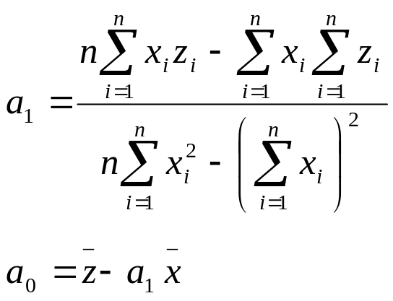

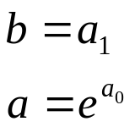
Transformation of data cont.
Using linear model regression methods,
Once
are found, the original constants of the model are found as

Slide 30
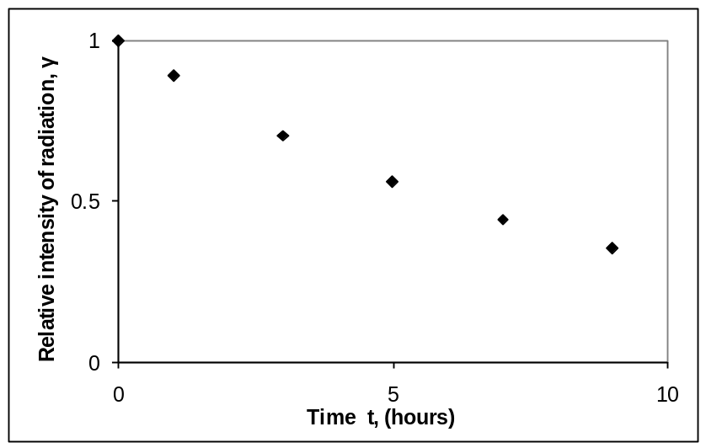
Example 3-Transformation of data
Many patients get concerned when a test involves injection of a radioactive material. For example for scanning a gallbladder, a few drops of Technetium-99m isotope is used. Half of the Technetium-99m would be gone in about 6 hours. It, however, takes about 24 hours for the radiation levels to reach what we are exposed to in day-to-day activities. Below is given the relative intensity of radiation as a function of time.
Table. Relative intensity of radiation as a function
of time
t(hrs) | 0 | 1 | 3 | 5 | 7 | 9
 | 1.000 | 0.891 | 0.708 | 0.562 | 0.447 | 0.355
Figure. Data points of relative radiation intensity
vs. time

Slide 31
Example 3-Transformation of data cont.
Find:
a) The value of the regression constants
and
b) The half-life of Technetium-99m
c) Radiation intensity after 24 hours
The relative intensity is related to time by the equation

Slide 32








Example 3-Transformation of data cont.
Exponential model given as,
Assuming
,
and
we obtain
This is a linear relationship between
and

Slide 33

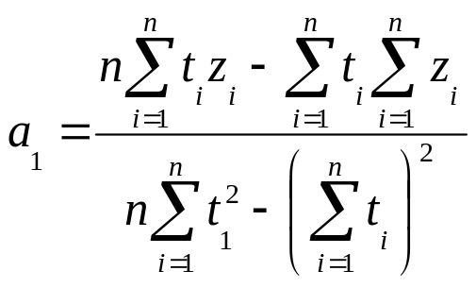



Example 3-Transformation of data cont.
Using this linear relationship, we can calculate
where
and

Slide 34

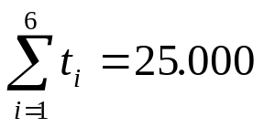






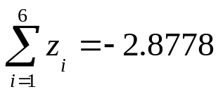
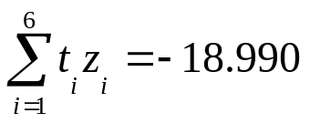

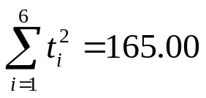
Example 3-Transformation of Data cont.
Summations for data transformation are as follows
With
Table. Summation data for Transformation of data model
1 2 3 4 5 6 | 0 1 3 5 7 9 | 1 0.891 0.708 0.562 0.447 0.355 | 0.00000 −0.11541 −0.34531 −0.57625 −0.80520 −1.0356 | 0.0000 −0.11541 −1.0359 −2.8813 −5.6364 −9.3207 | 0.0000 1.0000 9.0000 25.000 49.000 81.000
 | 25.000 |  | −2.8778 | −18.990 | 165.00

Slide 35
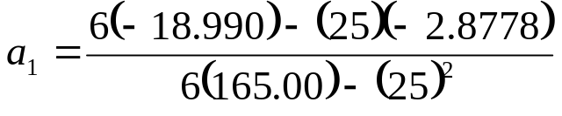

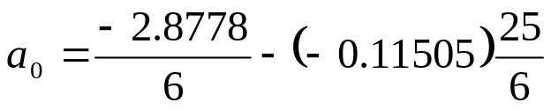






Example 3-Transformation of Data cont.
Calculating
Since
also

Slide 36

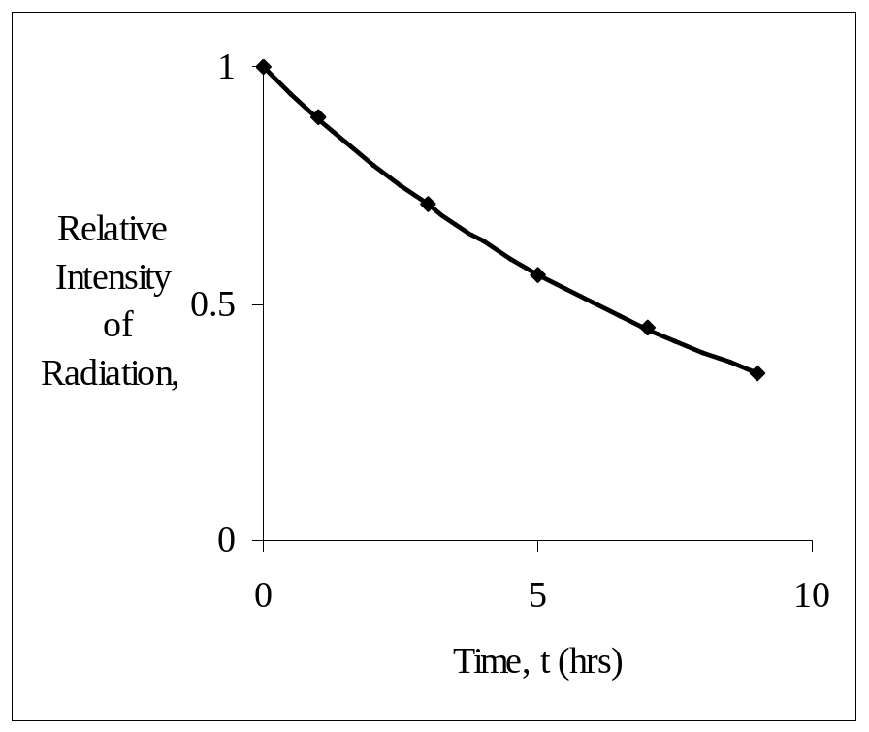

Example 3-Transformation of Data cont.
Resulting model is
Figure. Relative intensity of radiation as a function of temperature using transformation of data model.

Slide 37
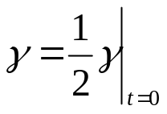

Example 3-Transformation of Data cont.
The regression formula is then
b) Half life of Technetium-99m is when

Slide 38



Example 3-Transformation of Data cont.
c) The relative intensity of radiation after 24 hours is then
This implies that only
of the radioactive
material is left after 24 hours.

Slide 39

Comparison
Comparison of exponential model with and without data Transformation:
Table. Comparison for exponential model with and without data
Transformation.
 | With data Transformation (Example 3) | Without data Transformation (Example 1)
A | 0.99974 | 0.99983
λ | −0.11505 | −0.11508
Half-Life (hrs) | 6.0248 | 6.0232
Relative intensity after 24 hrs. | 6.3200×10⁻² | 6.3160×10⁻²

Slide 40
THE END

